Slide 1




Lecture Title:
Chronic Health & Infections
University of Basrah Al-zahraa medical college
Ministry of higher Education and Scientific Research
Module: Infection & Immunity
Semester: 5
Session: 9, Lecture:1
This Lecture was prepared by module Staff:
Dr. Ban M. Saleh
Dr. Hussein K. Abdul-Sada
Dr. Hazim T. Thwany
Dr. Wameedh Hashim Alqatrani
Dr. Farqad M. Al-Hamdani
Dr. Abeer Al-Emara
Dr. Shant Sunbat
Dr. Zainab Khalid
Dr. Ilham Mohamed Jawad
This Lecture was loaded in blackboard and you can find the material in: Jawetz Melnick & Adelbergs Medical Microbiology, 28e. 2019,
For more detailed instructions, any question, or you have a case you need
help in, please post to the group of session

Slide 2
University of Basrah Al-zahraa medical college
Ministry of higher Education and Scientific Research
Learning Objectives (LO)
1. Describe the diversity of chronic infections
2. Consider the impact of chronic infections
3. Consider the role of infections in chronic health conditions with particular attention to diabetes mellitus, cystic fibrosis, hydatid cyst and Down’s syndrome.
4. Describe the role of Pseudomonas aeruginosa as an important organism in cystic fibrosis.
2

Slide 3
University of Basrah Al-zahraa medical college
Ministry of higher Education and Scientific Research
Chronic Infection
LO. 1
An infection characterized by delayed onset and slow progression .
Some of the examples that lead to chronic infection
1-Chronic granulomatous disease
Bacterial growth rate often moderate or slow
Organisms often survive and grow intracellularly
Immune damage occurs with infection predominantly mediated.
3

Slide 4
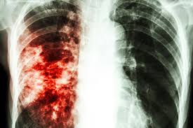


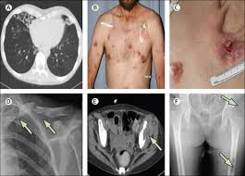
University of Basrah Al-zahraa medical college
Ministry of higher Education and Scientific Research
Chronic granulomatous infection
LO. 1
Tuberculosis
Leprosy
Listeria
https://www.hsph.harvard.edu/
https://emedicine.medscape.com/
Non-tuberculosis Mycobacteria
https://medium.com/@healthybabyinfo/listeria
https://www.sciencedirect.com/science
4

Slide 5
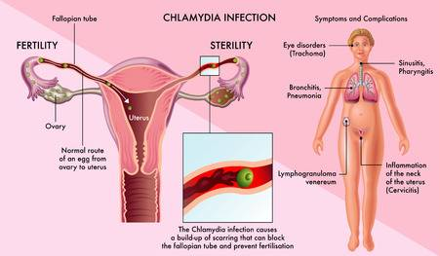
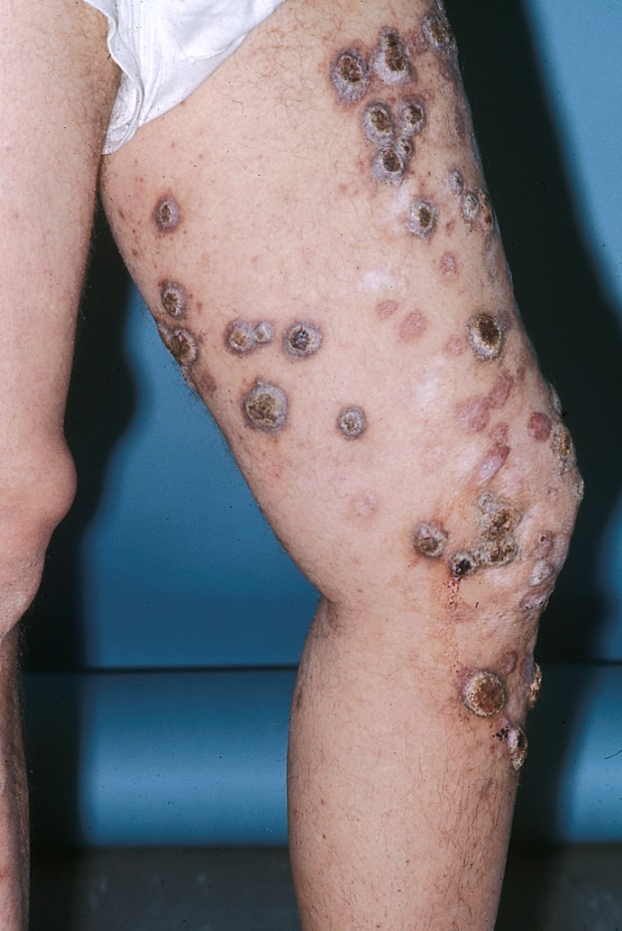
University of Basrah Al-zahraa medical college
Ministry of higher Education and Scientific Research
Chronic granulomatous infections
LO. 1
Some Fungi
(Coccidioides & Histoplasma)
Some Chlamydial infections
Some Parasites (Schstosoma and Lieshmania)
5

Slide 6
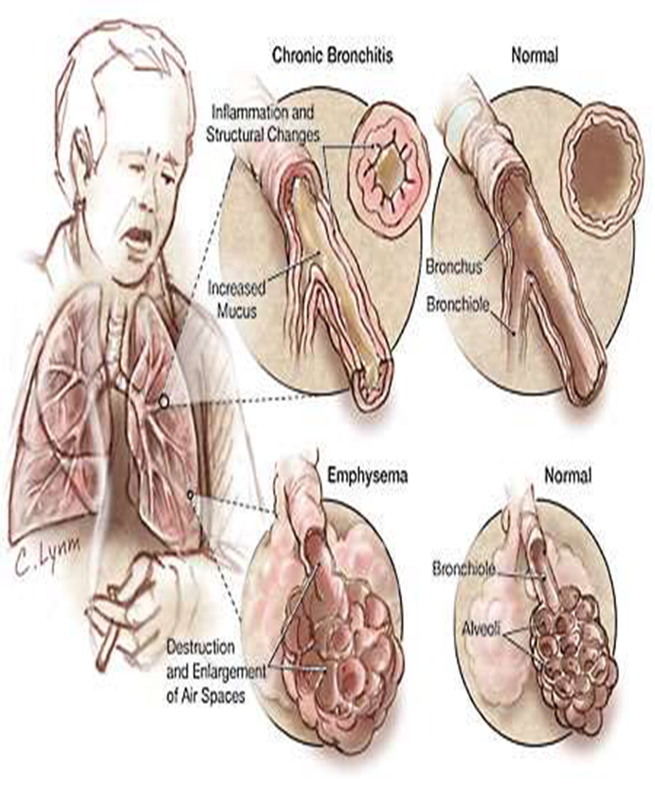
University of Basrah Al-zahraa medical college
Ministry of higher Education and Scientific Research
2- Chronic obstructive pulmonary disease (COPD)
LO. 1
Chronic inflammatory response to inhaled irritants, primarily mediated by neutrophils and macrophages.
Breakdown of lung tissue (emphysema) and small airways disease (obstructive bronchiolitis)
Increased mucus production
6

Slide 7
University of Basrah Al-zahraa medical college
Ministry of higher Education and Scientific Research
2- Chronic obstructive pulmonary disease
LO. 1
Microbiology of acute exacerbations of COPD
Bacterial
S. pneumoniae
H. influenzae
Moraxella catarrhalis
P. aeruginosa
E. coli
Viral
Respiratory syncytial virus
Rhinovirus
Parainfluenza virus
Human metapneumo virus
Coronavirus
Adenovirus
Influenza A virus
7

Slide 8
University of Basrah Al-zahraa medical college
Ministry of higher Education and Scientific Research
Impact of chronic disease and infections
LO. 2
Pathogen
Infection
Management
Outcome
Patient
8

Slide 9
University of Basrah Al-zahraa medical college
Ministry of higher Education and Scientific Research
Chronic diseases
LO. 2
Acquired:
– Vascular
– Infective
– Traumatic
– Autoimmune
– Metabolic
– Inflammatory
– Neurological
– Neoplastic
– Degenerative
– Environmental
– Idiopathic
Congenital:
– Genetic
– Developmental
9

Slide 10
University of Basrah Al-zahraa medical college
Ministry of higher Education and Scientific Research
LO. 2
Chronic diseases and infection
Improvements in healthcare are leading to increasing numbers of people with chronic illnesses living for longer.
Many chronic illnesses predispose to infection, often of a specific and predictable pattern
The chronic disease is influenced by:
social, economic and environmental factors
health behaviours and risk factors
10

Slide 11
University of Basrah Al-zahraa medical college
Ministry of higher Education and Scientific Research
LO. 2
Chronic diseases and infection
Chronic disease is largely preventable.
There are 4 major health damaging behaviours
  tobacco smoking
  poor nutrition
  alcohol misuse
  physical inactivity
11

Slide 12
University of Basrah Al-zahraa medical college
Ministry of higher Education and Scientific Research
Role of infections in chronic health conditions
LO. 3
Diseases can predispose to specific and characteristic infections.
Successful management of these chronic illnesses needs to take these infections into account .
A number of some chronic illnesses / infections combinations are presented.
12

Slide 13
University of Basrah Al-zahraa medical college
Ministry of higher Education and Scientific Research
Role of infections in chronic health conditions
LO. 3
Chronic diseases cause a change in the structure or function of affected tissues/organs which may have the potential for changing the interaction between the patient and micro-organisms.
This may be subsequently and further affected by changes caused by:
The altered presence of micro-organisms and the consequences of treatment, e.g. antibiotics and steroids
13

Slide 14
University of Basrah Al-zahraa medical college
Ministry of higher Education and Scientific Research
Diabetes and infections
LO. 3
Hyperglycemia and acidemia impair:
Humoral immunity
Polymorphonuclear leukocyte and lymphocyte functions
Diabetic microvascular and macrovascular disease result in poor tissue perfusion and increased risk of infection
Diabetic neuropathy causes diminished sensation resulting in unnoticed skin
14

Slide 15
University of Basrah Al-zahraa medical college
Ministry of higher Education and Scientific Research
Diabetes and infections
LO. 3
Type of infections that diabetic patients particularly prone to are
Soft tissue and skin infections
Respiratory infections in DM patients 6 times more likely to require hospitalization during a flu epidemic compared to non-diabetic population
Urinary tract infections
ENT infections
15

Slide 16
University of Basrah Al-zahraa medical college
Ministry of higher Education and Scientific Research
Diabetes and infections
LO. 3
Soft tissue and skin infections
Sensory neuropathy, atherosclerotic vascular disease, and hyperglycemia all predispose to an increased risk of skin and soft tissue infection
Causative organisms include:
Staphylococcus aureus (folliculitis, cellulitis)
β-haemolytic Streptococcus (cellulitis)
Polymicrobial including Enterobacteriaceae, Staph aureus, β-haemolytic streptococci, and various Anaerobes (Diabetic foot ulcers and necrotising fasciitis)
16

Slide 17
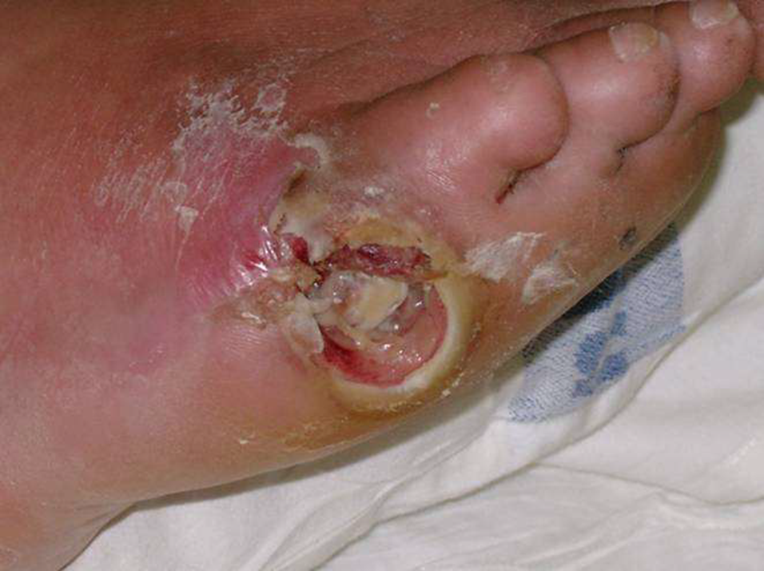
University of Basrah Al-zahraa medical college
Ministry of higher Education and Scientific Research
Diabetes and infections LO. 3
Diabetic foot ulcer
17

Slide 18
University of Basrah Al-zahraa medical college
Ministry of higher Education and Scientific Research
Advice to develop diabetic foot ulcer
LO. 3
Regular feet examination to identify any problem area
Good glycemic control and avoid other risk factor of arterial disease such as smoking and hypertension high cholesterol
Good foot care through
Avoid walking bare foot
Use moistening cream
Wear well fitting shoes
Do not cut toe nails too short
18

Slide 19
University of Basrah Al-zahraa medical college
Ministry of higher Education and Scientific Research
Diabetes and infections
LO. 3
ENT infections
Malignant or necrotizing Otitis Externa
Infection with Pseudomonas aeruginosa starts in the external auditory canal and spreads to adjacent soft tissue, cartilage, and bone.
Patients typically present with severe ear pain and Otorrhoea.
19

Slide 20
University of Basrah Al-zahraa medical college
Ministry of higher Education and Scientific Research
Diabetes and infections
LO. 3
ENT infections
Rhinocerebral mucormycosis
In patients with poorly controlled diabetes, especially those with diabetic ketoacidosis, Mould fungi, Organisms colonize the nose and paranasal sinuses, spreading to adjacent tissues by invading blood vessels and causing soft tissue necrosis and bony erosion.
20

Slide 21
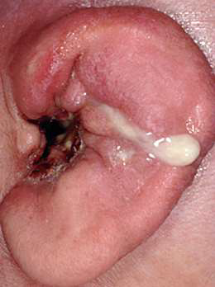
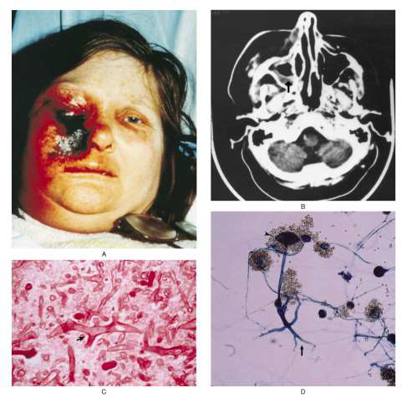
University of Basrah Al-zahraa medical college
Ministry of higher Education and Scientific Research
Diabetes and infections
LO. 3
ENT infections
21

Slide 22
University of Basrah Al-zahraa medical college
Ministry of higher Education and Scientific Research
Diabetes and infections
LO. 3
Urinary tract infections
Neurogenic bladder due to diabetic neuropathy leads to defects in bladder emptying (risk factor).
Increased risk of asymptomatic bacteriuria and pyuria, cystitis and upper urinary tract infection
The main causative agents is Enterobacteriaceae (e.g. E. coli , P. aeruginosa).
22

Slide 23
University of Basrah Al-zahraa medical college
Ministry of higher Education and Scientific Research
Cystic fibrosis
LO. 3
Organs principally affected by Cystic Fibrosis
1- Respiratory system- repeated inflammation and infection
2- Pancreas- blockage of the ducts leads to decreased release of digestive enzymes from the pancreas
3- Urogenital system- absence of the vas deferens in men leads to infertility and female has thick cervix mucus lead in infertility
4- GI tract- rectal prolaps, constipation and malabsorption
23

Slide 24
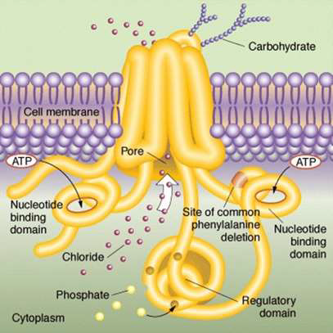
University of Basrah Al-zahraa medical college
Ministry of higher Education and Scientific Research
Cystic fibrosis and infection
LO. 3
Pathogenesis of Cystic Fibrosis
Autosomal recessive
Defect in cystic fibrosis transmembrane conductance regulator (CFTR) gene in exocrine glands
Range of different mutations
Most frequent is DF508 (Deletion of phenylalanine at position 508)
24

Slide 25
University of Basrah Al-zahraa medical college
Ministry of higher Education and Scientific Research
Cystic fibrosis and infection
LO. 3
Clinical consequences of CFH
Defect in CFTR leads to defects in Cl⁻ transmembrane transport
Mucus becomes dehydrated and thick causing blockage in small ducts (bronchioles and pancreas)
Lung colonization and infection with a procession of different organisms
25

Slide 26
University of Basrah Al-zahraa medical college
Ministry of higher Education and Scientific Research
LO. 3
Prevention of respiratory infections developing in cystic fibrosis patients can be done by:
1-Encourage mucus clearance through
Chest physiotherapy
Hypertonic saline nebulizers
Mucolytics
Bronchodilators
Sometimes steroids are used to reduce inflammation
2-Prevent colonization through
Prophylactic antibiotics
Avoid mixing with other cystic fibrosis patients
Good hand hygiene
Maintain good nutrition
26

Slide 27


University of Basrah Al-zahraa medical college
Ministry of higher Education and Scientific Research
Hydatid cyst and infections
LO. 3
The causative agents is Echinococcus granulosus
It is an important pathogenic, zoonotic, and parasitic infection (acquired from animals).
Symptoms developed depend on location of the cyst, but most occur in liver, lung or both.
Scolexes of the Echinococcus contain four suckers
The scolexes of the organism attach to the intestine of the definite host and developed into adult in 32-80 days.
27

Slide 28
University of Basrah Al-zahraa medical college
Ministry of higher Education and Scientific Research
LO. 3
Common bacteria associated with hydatid cyst
E. coli
Streptococcus fecalis
Pseudomonas
Klebsialla pneumonia
Proteus vulgaris
Bcteroides
Staphylococcus and Streptococcus (endocarditis)
28

Slide 29
University of Basrah Al-zahraa medical college
Ministry of higher Education and Scientific Research
LO. 3
Down’s syndrome
Autosomal disorder because it affects the chromosome 21, which is an autosome.
Down syndrome is either a dominant nor recessive trait because it is just an error in the “ translation “ process of chromosome 21.
29

Slide 30
University of Basrah Al-zahraa medical college
Ministry of higher Education and Scientific Research
LO. 3
Risk factors
Advancing maternal age- usually women of age 35 and above.
Mothers who already have one child with down syndrome- increase risk for subsequent pregnancies.
Parents who are carries of the genetics translocation for down syndrome.
30

Slide 31
University of Basrah Al-zahraa medical college
Ministry of higher Education and Scientific Research
Down’s syndrome and infection
LO. 3
Respiratory tract infections (viral and bacterial) more common
in young people with Down's Syndrome.
Due to true immunodeficiency or to other factors, e.g. altered
mucus secretion or the structure of the mouth and airways.
An otherwise healthy person with Down's Syndrome will probably not suffer many more serious infections than his or her siblings and will respond to vaccination.
31

Slide 32
University of Basrah Al-zahraa medical college
Ministry of higher Education and Scientific Research
LO. 4
Pseudomonas aeruginosa in CF
The pathogenesis of Pseudomonas aeruginosa infection is complex and includes:
Defective ingestion of bacteria by epithelial cells
Abnormal composition of airway surface liquid leading to impaired function of anti-microbial peptides
  3. Abnormal function of the cells of the innate immune system:
32

Slide 33
University of Basrah Al-zahraa medical college
Ministry of higher Education and Scientific Research
LO. 4
For example respiratory macrophages do not function normally in patients with cystic fibrosis (with a complex interaction of the CFTR gene abnormality and macrophages affecting signaling and phagocytosis)
In the immunocompromised Pseudomonas can spread to cause severe systemic infections.
Additionally it has a high level of antibiotic resistance and finding effective therapy can be challenging.
33

Slide 34
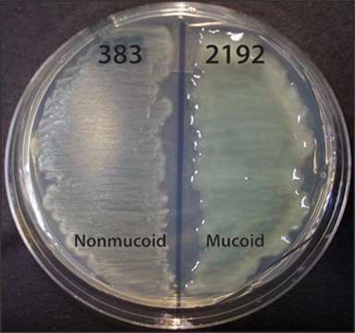
University of Basrah Al-zahraa medical college
Ministry of higher Education and Scientific Research
Mucoid Pseudomonas aeruginosa in CF
LO. 4
34

Slide 35
